Slide 1
Principal Components
UIUC ECON 490: Applied Machine Learning in Economics

Slide 2
So you downloaded 100 variables…
Don’t panic!
Use regularization!
But what if I told you…
Grab just important bits of information of 100 variables in fewer than 100 principal components

Slide 3
Golly gee! What’s a principal component?
An eigenvector!
Never mind, sorry I asked.
Eigenvector – the direction data stretches in space
All are orthogonal
Eigenvalue – how much the vector stretches space
From unit vector

Slide 4
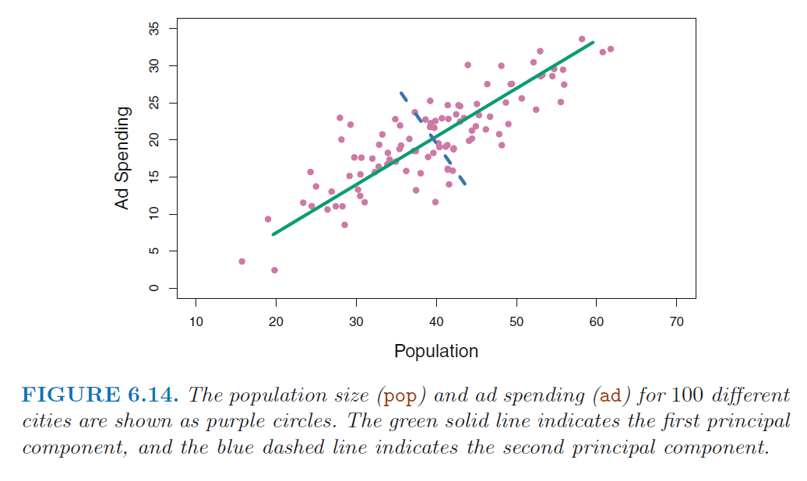
Visually – Eigenvectors and Eigenvalues

Slide 5
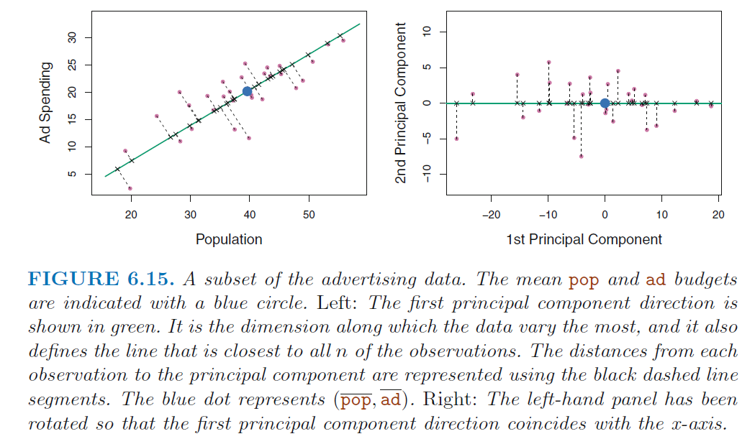
Visually – Basis

Slide 6
Visually – 3D

Slide 7
Principal Component Notes

Slide 8
Principal Component Notes
In finance:
1st component – level
2nd component – slope
3rd component – curve
Pros
Dimension reduction
Cons
Lose interpretation
Scale Matters

Slide 9
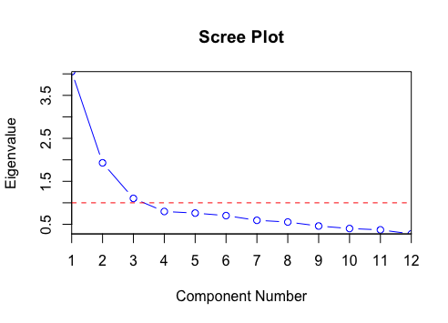
Choosing Number of Components

Slide 10
Choosing Number of Components
CROSS-VALIDATION!!!

Slide 11
To Do
Complete
Lab 6.7
Read
Chapter 7 (yup)

